Slide 1
CP 1.5 - Kaggle Winning Solutions
Team Members: Sneha Gonipati, Zinnia Waheed, Aiah Aly, Heron Ziegel, Faisal Shaikh
Notes:
https://www.kaggle.com/code/nielsc/hotel-id-starter-similarity-training

Slide 2
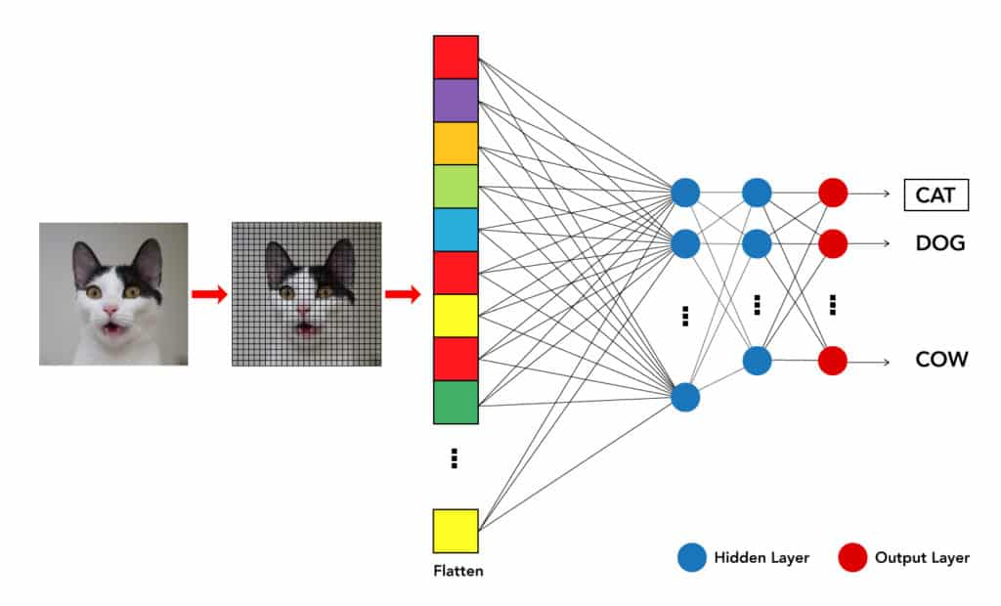
Problem description:
What is the data science problem to be solved?
Develop a machine learning model to match images of hotel rooms to their respective hotels.
Automate the identification process based on visual evidence from photographs.
Improve efficiency compared to manual analysis
Notes:
Problem description:
What is the data science problem to be solved?
The data science problem is developing a machine learning model that can match images of hotel rooms to their respective hotels. This solution aims to automate the identification process based on visual evidence from photographs, improving efficiency compared to manual analysis.
https://d1m75rqqgidzqn.cloudfront.net/wp-data/2020/06/15133800/Blog-Image-11-6-2020-01-1-1024x620.jpg

Slide 3
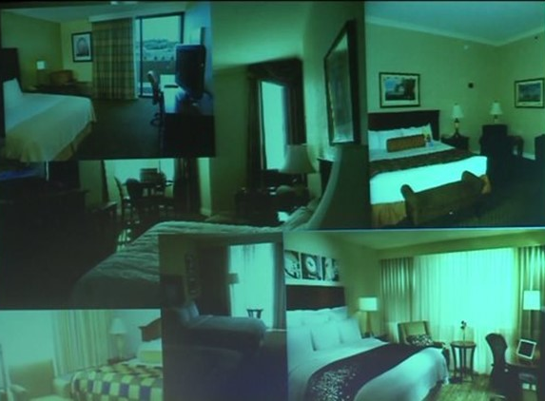
Problem description:
What was the motivation/importance of the problem?
Human trafficking often occurs in concealed environments like hotel rooms.
Limited visual evidence makes victim location identification difficult.
Hotel room photographs are key clues, but manual analysis is slow and error-prone.
AI-driven solutions can enhance response times and improve rescue operations.
This project demonstrates AI’s role in addressing human rights challenges.
Notes:
What was the motivation/importance of the problem?
Human trafficking is a widespread global issue that often occurs in concealed environments like hotel rooms. Law enforcement and organizations face significant challenges in identifying the locations of victims due to limited visual evidence. Photographs from hotel rooms are often the only clues, but manually analyzing them is time-consuming, labor-intensive, and error-prone. Given the thousands of unique hotel room configurations, an automated, scalable solution is necessary to enhance response times and rescue operations. The project also demonstrates how AI can be leveraged to address societal human rights issues, highlighting its broader significance.
https://media.tegna-media.com/assets/WNEP/images/364a0416-072e-4434-98cc-722361ccac39/364a0416-072e-4434-98cc-722361ccac39_750x422.jpg

Slide 4
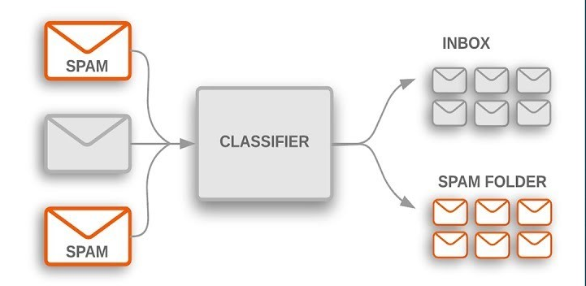
Problem description:
What were the classification labels?
The model identifies the hotel where an image was taken
Traffickers post photos in hotel rooms; identifying the hotel aids law enforcement and NGOs
The task involves classifying images into hotel categories based on visual features
Each image is labeled with a unique hotel ID, representing the specific hotel
Notes:
What were the classification labels?
The challenge aimed to develop a model capable of identifying the hotel where a presented image was taken. Accurately identifying hotels from images can be a crucial tool in combating human trafficking. Traffickers often post photos of victims in hotel rooms thus being able to determine the specific hotel ID can assist law enforcement and NGO’s in locating/rescuing victims. This task involved classifying images into numerous hotel categories based on several visual features. Each image in the dataset was labeled with a unique hotel ID number, representing the specific hotel where the image was captured.
https://media.licdn.com/dms/image/C4D12AQFvkvRW2wQlxQ/article-cover_image-shrink_720_1280/0/1650384205682?e=2147483647&t=SBcZskc1LhVfOo2iosedUq2f4QWOm4k_CfT2MKwcG78&v=beta

Slide 5
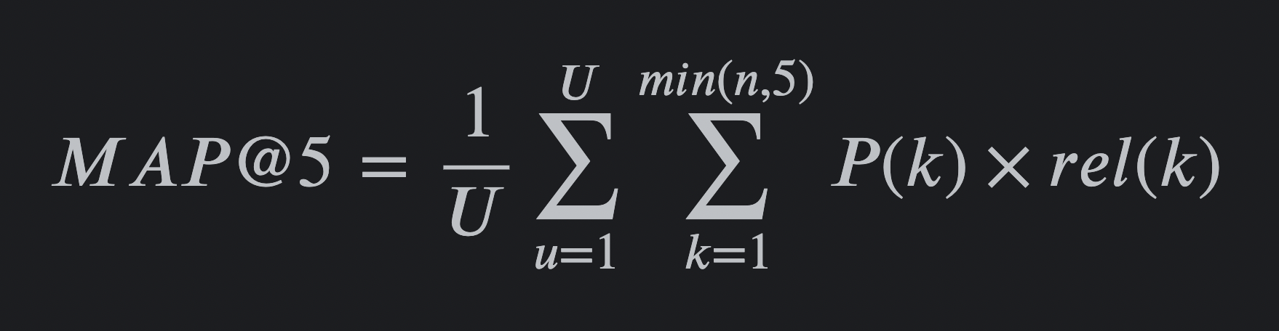
Evaluation Metric:
How was the success of proposed solutions evaluated by Kaggle?
The model generates a ranked list of the top 5 predicted hotel IDs for each image using mean average precision at 5 (MAP@5)
If the correct hotel ID appears in the top 5 rankings, the prediction receives partial credit based on the ranking
This metric assesses the average precision of predictions for each query image
Notes:
https://a.storyblok.com/f/139616/1200x800/09681b30bf/map-formula.webp
How was the success of proposed solutions evaluated by Kaggle?
The model generates a ranked list of the top 5 predicted hotel ID’s for each image using the mean average precision at 5. If the correct hotel ID appears in the top 5 ranking the prediction gets a partial credit based on the rating. This metric assesses the average precision of the prediction for each query image.

Slide 6

Kaggle Solution Stats
The MLiP team’s submission had a score of 0.305 based on Kaggle’s evaluation metric
Placed 36th on the leaderboard, with 20 entries submitted before their final solution

Slide 7
Feature Engineering
Embedding - Based Image Representation
Model learns feature-rich embeddings instead of direct classification
Uses Efficient Net-B0 (pretrained CNN) without final classification layer
Extracted CNN features pass through a linear embedding layer for vector representation
Embeddings are refined via a final classification layer for hotel ID prediction
Enables a distance-based similarity model while fine-tuning embeddings to capture unique hotel characteristics
Notes:
Zinnia
Embedding - Based Image Representation
Instead of directly classifying images, the model learns embeddings that capture key features of hotel images
Used a pretrained CNN (EfficientNet-B0) without the final classification layer
The extracted CNN features are passed through an embedding layer (linear layer) to obtain a vector representation
The embedding in then passed through another linear classification for hotel ID prediction
The embeddings allow us to use the primarily numerical, distance-based similarity model
The class prediction helps fine tune embedding so that they better represent the unique hotel characteristics

Slide 8
Feature Engineering
Similarity Search for Image Matching
Uses cosine similarity and euclidean distance to compare image embeddings
During the interface, the model:
Extracts embeddings from a query image
Finds the closest matching images from the training set
Ranks the top 5 most similar images for classification
Allows for more flexible than strict classification, as similar hotels can have overlapping visual features
Notes:
Zinnia

Slide 9
Feature Engineering
Handling class imbalance with rebalancing
The dataset had a high imbalance, with some hotels having hundreds of images while others had a few
As a result, the number of images per hotel were rescaled using a non-linear scaling function
Created a new balanced dataset (train_balanced.csv) with more representative hotel images
Prevented overfitting to dominant hotel classes
Improves generalization to unseen hotel images
Notes:
Zinnia

Slide 10
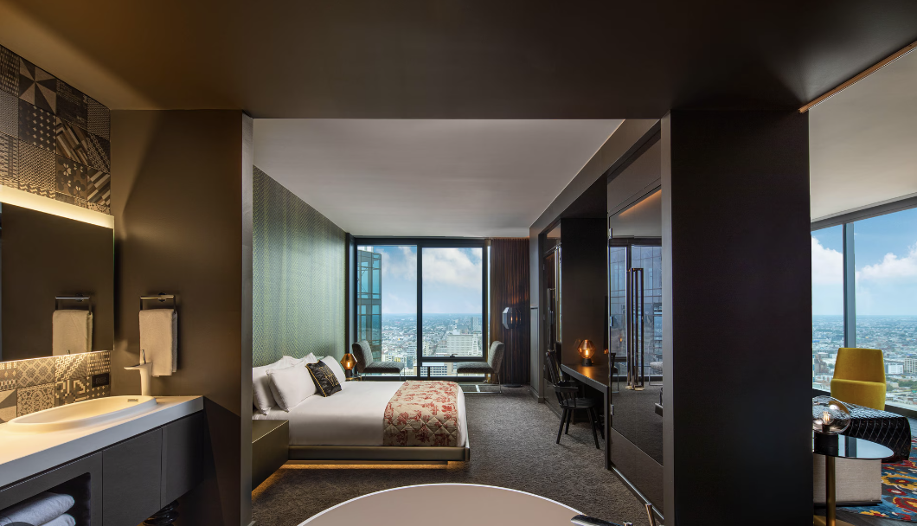
Data Augmentation
Coarse Dropout function blocked random patches in images with a solid color red to simulate occlusions
Mimics real world cases where furniture or other objects distort key image details
Trains the model to rely on more general features rather than specific objects
Prevents overfitting to small, easily obstructed objects
Normalization and tensor conversion
Standardizes image inputs for CNN models
Converts images to tensors for efficient GPU training
Allows for stable and faster model training
Notes:
Zinnia

Slide 11
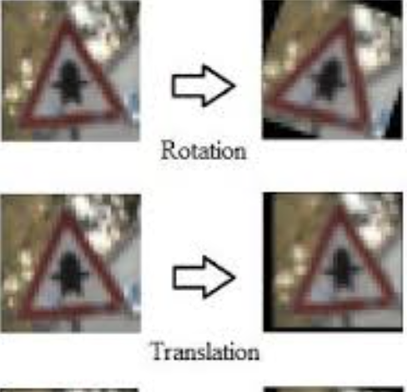
Data Augmentation
Geometric Augmentations
Vertical flips, shift scale, perspective transformations, optical distortions
All of these augmentations increase generalizations to unseen images and make the model invariant to unseen changes
Color Augmentations
Color jitter: adjust brightness, contrast, hue, saturation, randomly
Stimulates different lighting conditions
Prevents model from overfitting to specific lighting settings
Helps with variation in image exposure
Notes:
Zinnia

Slide 12
Feature Engineering and Augmentation Results
Without these augmentations, the model would overfit to clear, well lit images
With these augmentations, the model became resilient to occlusions, distortions, and lighting conditions.
The MAP@5 increased to 68.56%, meaning the similarity-based retrieval system was fairly effective
However, classification accuracy declined across epochs, possibly due to overfitting or class imbalance
Similarity accuracy: 0.5435 ( the model’s top 1 prediction was correct) MAP@5 0.6856 (the correct hotel was in the top 5 predictions)
Notes:
Zinnia

Slide 13





Solution:
What libraries/tools did the solution use? How did it help? Do we know how much this contributed to the performance of the algorithm?
Libraries: PyTorch, timm, Albumentations, scikit-learn, pandas, numpy, matplotlib, plotly, tqdm, PIL
Notes:
Main libraries:
PyTorch – Main deep-learning framework for building and training the model with GPU acceleration.
timm – Loads pre-trained models like EfficientNet, significantly improving accuracy by starting from strong feature representations.
Albumentations – Provides data augmentations (flips, color jitter, occlusions) to reduce overfitting and make the model robust to test image distortions.
scikit-learn (cosine similarity) – Computes similarity between image embeddings, allowing for more robust image retrieval in multi-class scenarios.
pandas, numpy – Data manipulation.
matplotlib, plotly – Visualization.
tqdm – Progress bars.
PIL – Image loading.

Slide 14
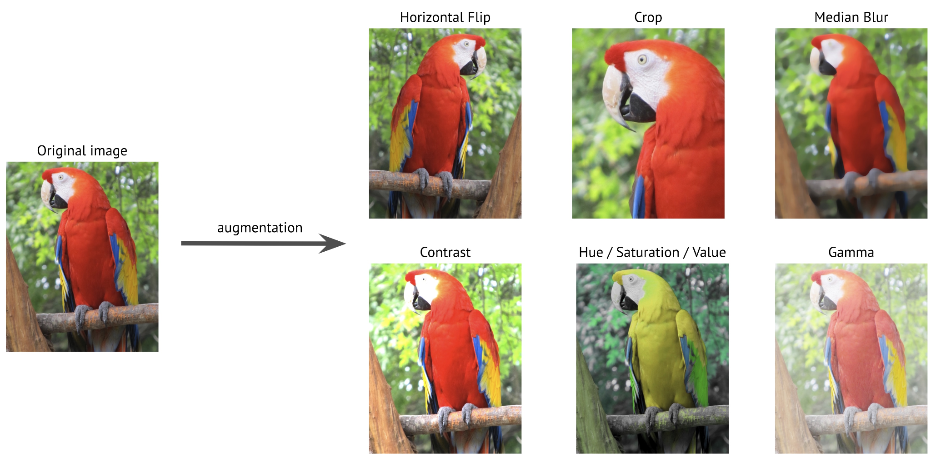
Solution:
Do we know how much this contributed to the performance of the algorithm?
Pretrained Backbone (timm): Speeds up learning with EfficientNet trained on ImageNet, improving accuracy.
Albumentations: Uses flipping, color changes, occlusions to reduce overfitting and enhance robustness.
Cosine Similarity: Matches image embeddings, improving retrieval when classification fails due to occlusions.
Notes:
Performance Contribution:
Pretrained Backbone (timm)
Uses a model (like EfficientNet) that was already trained on large datasets like ImageNet.
Helps the model learn faster and better without starting from scratch.
Albumentations (Data Augmentations)
Adds transformations like flipping, color changes, and occlusions to make the model more robust.
Helps prevent overfitting and improves generalization to real-world test images.
Cosine Similarity (Image Retrieval)
Compares image embeddings to find the closest matches.
Helps in cases where classification alone may fail, especially if test images are occluded or not well-represented in training.
https://albumentations.ai/docs/images/introduction/image_augmentation/augmentation.jpg

Slide 15
Solution:
Which Machine Learning algorithm(s) did the solution use? How did they help? Do we know how much this contributed to the performance of the algorithm?
CNN : The CNN effectively captured complex visual patterns necessary for distinguishing between a large number of hotel classes and extracted relevant features
Embedding Model: Took the features from the CNN and converted them into vectors
Classification Model: Used the embeds to determine which hotel an input image was from
Similarity Model: Used the CNN -> Embedding -> Classification model to determine the 5 hotels the input model was closest to with cosine similarity

Slide 16
Takeaways:
Do you see any elements that could be successfully adopted from the solution to the model being built by you/your peers?
Feature Extraction: Use CNN-extracted features with an embedding model for classification.
Augmentation Flexibility: Allows customizable feature augmentation to improve robustness.
Model Exploration: Enables testing different classification models for higher accuracy.
Notes:
Do you see any elements that could be successfully adopted from the solution to the model being built by you/your peers?
One potential takeaway is the processing method used by this solution. It may be useful to use the feature extraction of the CNN, take those features and add them to an embedding model, and then classify the now embedded data. That way we can add even more feature augmentation like this solution did, or change what augmentation we want to use. Or we could use the extracted and embedded features and find different classification models that may produce a higher accuracy.

Slide 17
Takeaways:
Are there any topic(s)/technology(ies) would you like to invest your time in learning more about?
Key Technologies to Explore: Checkpoints, embedding layers, and image-filtering techniques from the winning solution.
Model Integration: Plan to adopt the base model into our solution.
CNN Selection: A CNN with backpropagation is the most logical approach.
Image Filtering: Likely to incorporate some image filters for improved performance.
Notes:
Are there any topic(s)/technology(ies) would you like to invest your time in learning more about?
There are several technologies that we would like to learn more about that were used in the winning solution. These include checkpoints, embedding layers, and some of the image-filtering techniques. We would like to adopt at least the base model from this code into our solution. A CNN seems like the most logical model to use for this problem, as well as their use of backward propagation. We will probably end up using some of the image filters also.
https://www.baeldung.com/wp-content/uploads/sites/4/2023/01/embedding_layer.png

